Slide 1

REAL - TIME SENTIMENT ANALYSIS OF TWEETS
Presented by : SHRUTI BADAGANDI
1

Slide 2

INTRODUCTION
Real-time sentiment analysis is a growing need in digital communication.
Twitter is a widely used platform for opinions.
Understanding public mood helps businesses, media, and governments.
Social media platforms, especially Twitter, are full of real-time public opinions. Analyzing these tweets can help us understand public sentiment about topics like elections, festivals, and news events. In this project, I built a system that can read, clean, translate, analyze, and visualize public sentiment from tweets written in Kannada, Hindi, and English.

Slide 3

DATASET OVERVIEW
The dataset used is RealTime-TweetDataset.csv, containing over 10,000 tweets in three languages: English, Hindi, and Kannada. Each tweet includes metadata such as the timestamp, user location, and raw text. The sentiment expressed in the tweet is the primary feature of interest. By leveraging this data, I can classify tweets into sentiment categories and analyze the results across different dimensions like time & Language.
3

Slide 4
Text Preprocessing & Language Detection
Before analyzing sentiment, I cleaned the text to remove unnecessary parts like URLs, @mentions, and emojis. I also converted all text to lowercase and removed extra spaces. This step ensures our NLP models work on clean, normalized input, improving accuracy.
Since tweets were in different languages, I used langdetect to detect whether a tweet was in English, Hindi, or Kannada. Non-English tweets were then translated to English using TextBlob. This step made sure all tweets were in English before sentiment analysis, allowing us to use English-only models effectively.
4

Slide 5

Sentiment Classification
I Used the TextBlob library to assign a polarity score to each tweet. Based on polarity:
Positive score → Positive sentiment
Negative score → Negative sentiment
Zero score → Neutral sentiment Each tweet was classified into one of the three categories. This method is simple yet effective and works across multiple languages when combined with pre-cleaned text.
4

Slide 6
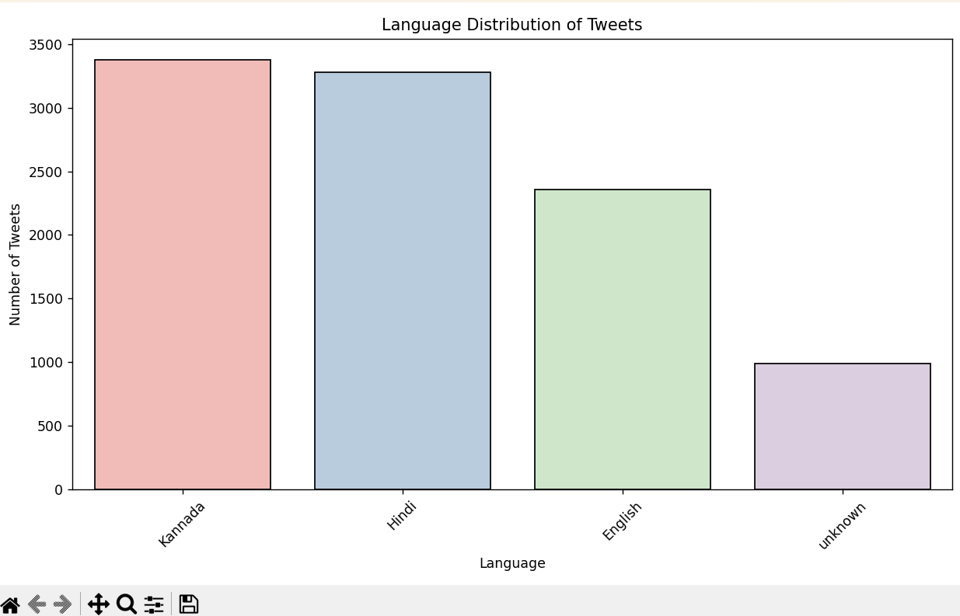
Language Distribution Visualization
A bar chart was used to show how many tweets were posted in each language. English tweets formed the majority, followed by Hindi and Kannada. This insight helped us understand the primary communication languages used by users and gave us direction on focusing language-specific sentiment analysis for different regions.

Slide 7
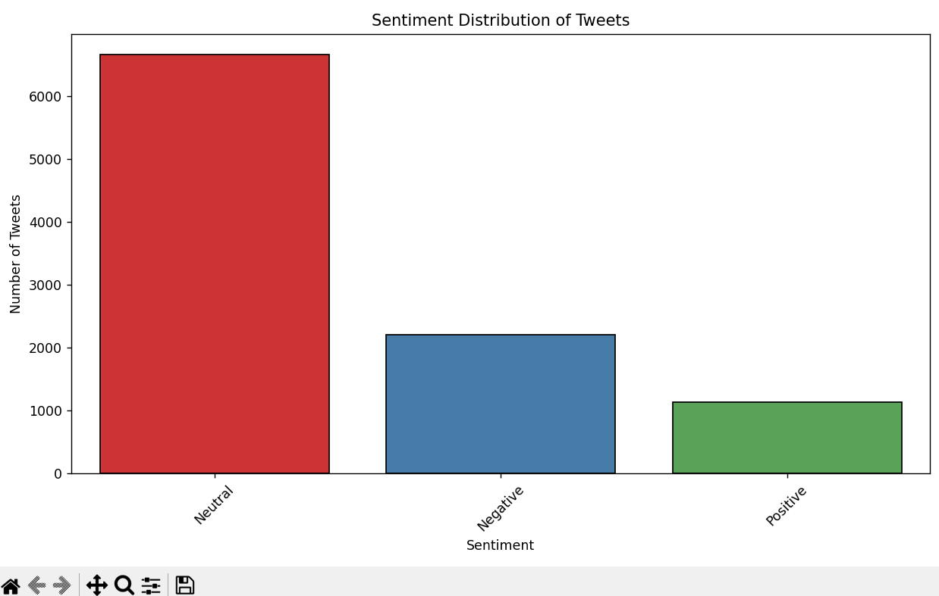
Sentiment Distribution Visualization
This bar chart was used to present the distribution of tweets based on sentiment categories. We found that a large portion of the tweets expressed positive sentiment, followed by neutral and negative. This gave an overall optimistic tone to the dataset but also emphasized the need to monitor for sudden spikes in negative sentiment.

Slide 8
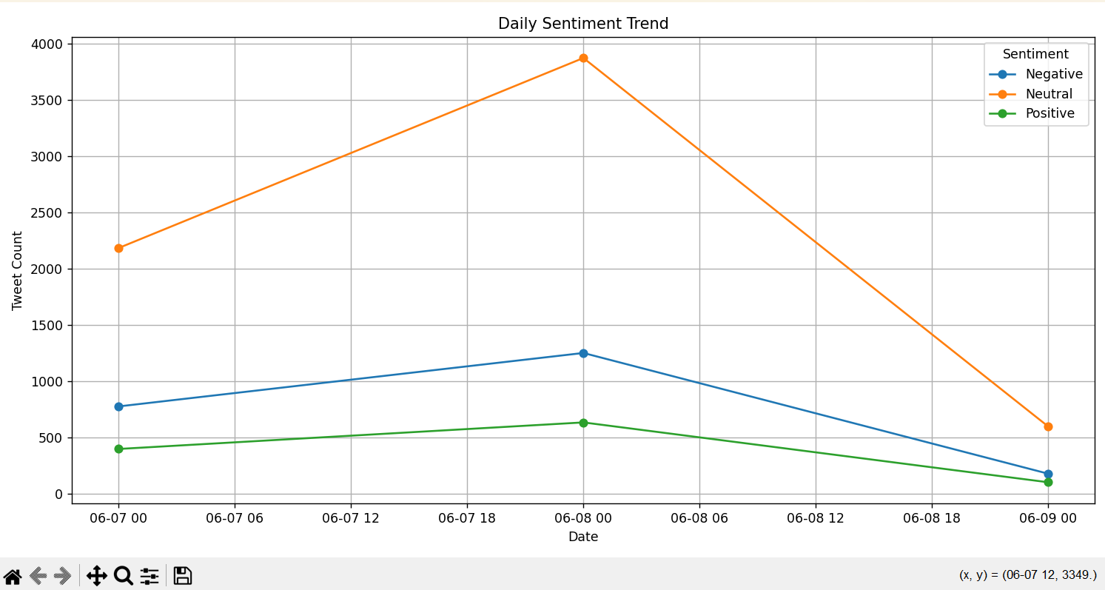
Sentiment Trends Over Time
Using the tweet Timestamp, we created a line graph to show how sentiment evolved on a daily basis. This helped identify trends like increases in negativity during controversial events or spikes in positivity during festivals or celebrations. Time-based analysis is vital for tracking changes in public mood.

Slide 9
Streamlit Web App
To make the project interactive and user-friendly, we built a web app using Streamlit. Key features:
Upload or process real-time tweet data
View KPIs: total tweets, language count, location count
Filter by sentiment and language
Explore time-based and location-based sentiment charts
Export filtered results to CSV The app allows users to explore data without coding, making sentiment analysis accessible to a wide audience.
9

Slide 10
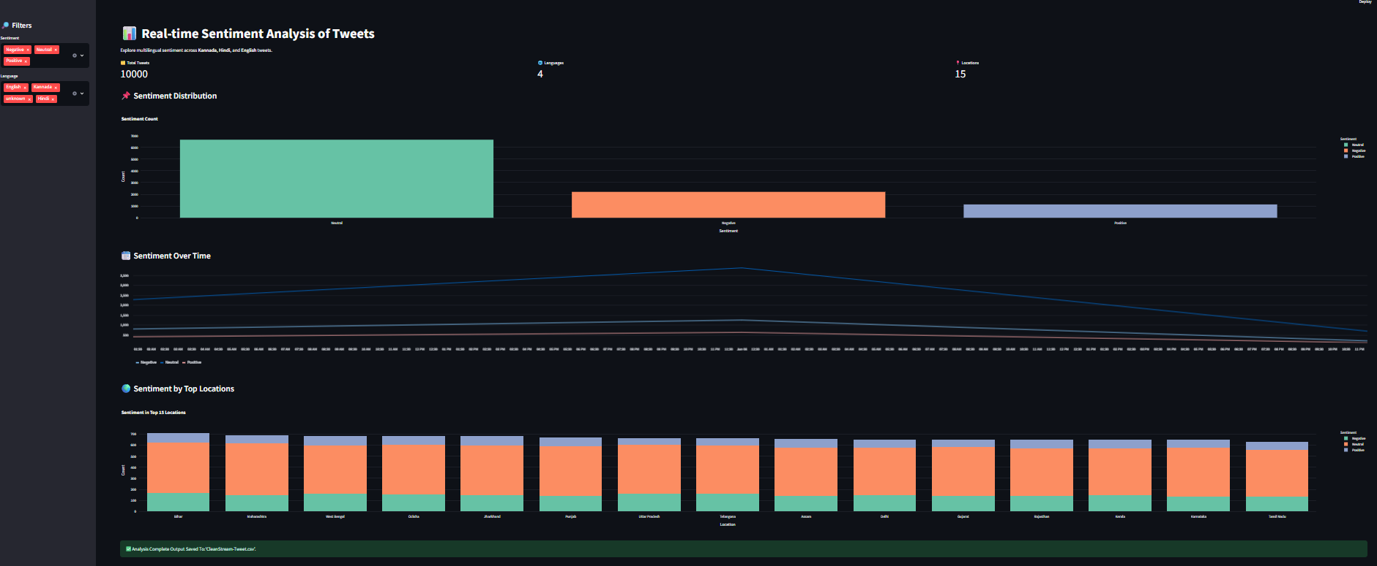

Slide 11
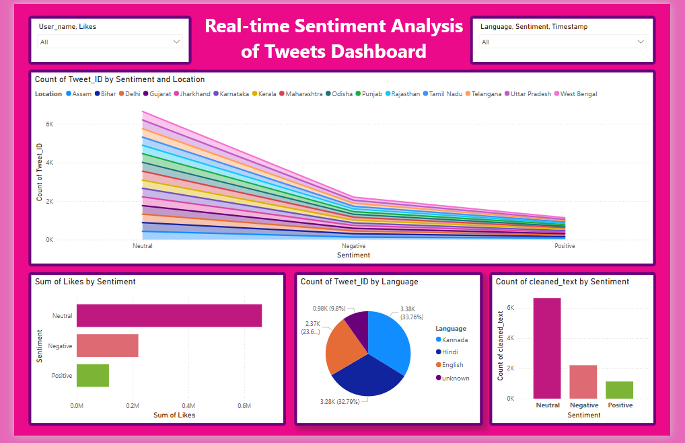
DASHBOARD
Created using Power BI
Real-time filters
Visual insights for business users
Maps, pie charts, bar graphs
For business audiences, we created a Power BI version of the dashboard. It allows managers to quickly review tweet sentiment using visual KPIs and maps, and it supports drill-down features for more detail.

Slide 12

CONCLUSION
This project showcased a full NLP pipeline using real-world social media data. From multilingual text preprocessing and language detection to sentiment classification and interactive visualizations, it demonstrates how data science can transform raw text into actionable public opinion trends. The addition of a web app makes it useful for real-time analysis in media, politics, and customer feedback.
5

Slide 13
THANK YOU
10

